Slide 1
Stanford ME469: Nalu Overview
Stefan P. Domino
Computational Thermal and Fluid Mechanics
Sandia National Laboratories SAND2018-4619 PE

Slide 2
Nalu Overview: Outline
Nalu Technology Origination: ASC
Beyond the 32-bit Limit
Supported Physics
Supported Numerics
Low- and High-order
Moving Mesh (Sliding and Overset)
Multiphysics:
Fluid Structure Interaction
Conjugate Heat Transfer (CHT)
Participating Media Radiation
Examples
Conclusion

Slide 3
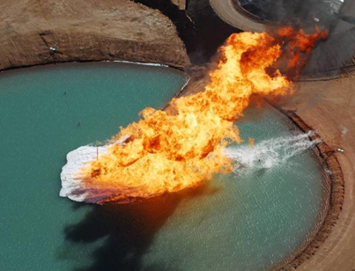
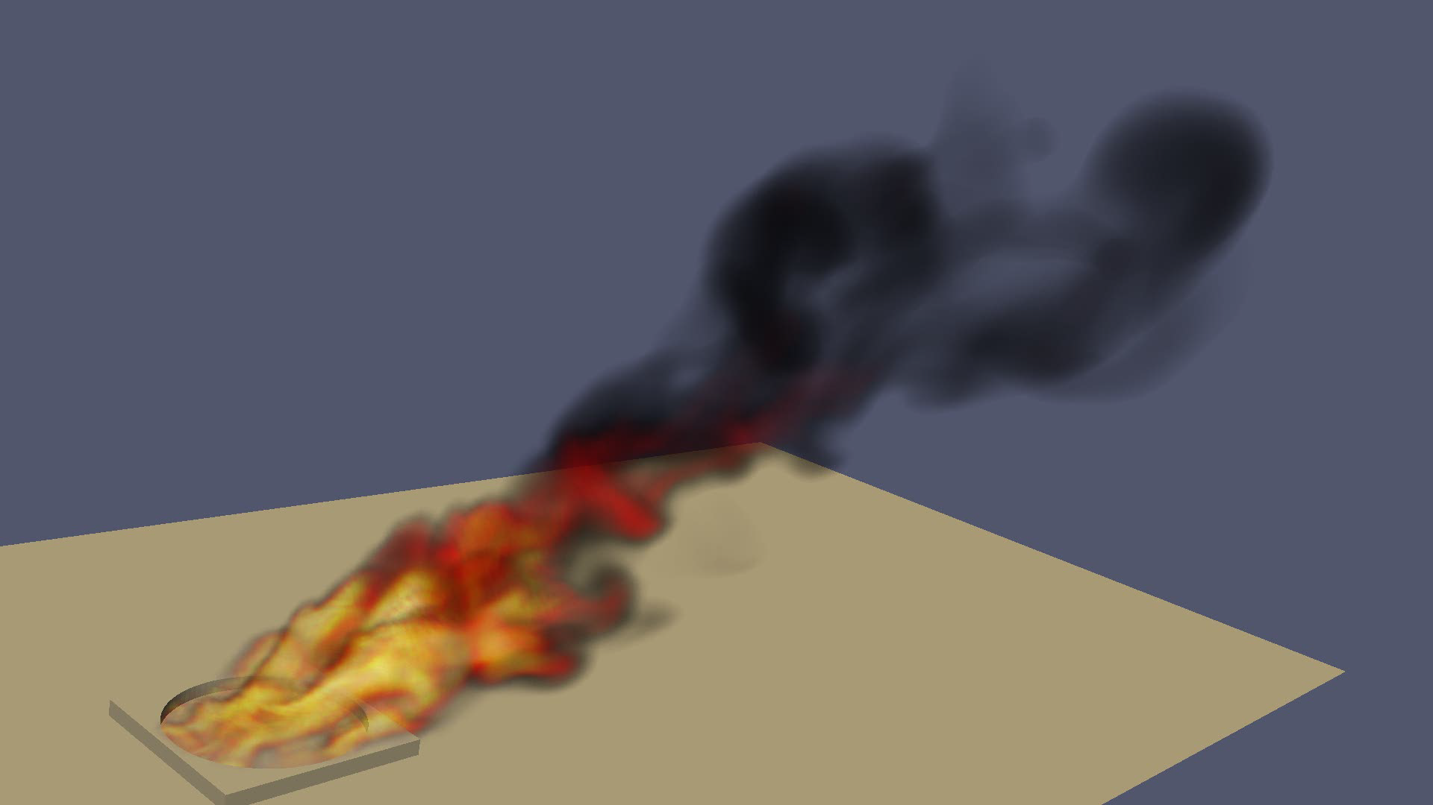
Core Technology Provided to Nalu Origination: Advanced Simulation and Computing Sierra/Fuego
Use-case characterized by a highly sooting, turbulent, reacting flow with Participating Media Radiation (PMR), Conjugate Heat Transfer (CHT), and propellant multi-physics coupling
Complex geometry has driven a generalized, hybrid unstructured discretization approach supporting Hex8, Tet4, Wedge6, and Pyramid5 elements in addition to arbitrary promotion of Hex8 to Hex27, Hex64, etc.

Slide 4
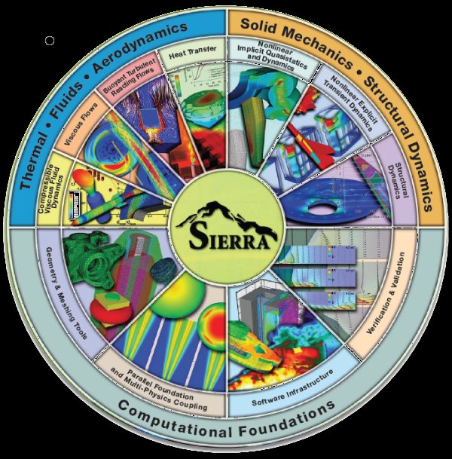


Goal: Beyond 32-bit Computing
Circa 2013, many scientific production codes were limited to 32-bit
Therefore, maximum simulation size for entities, e.g., node, edge, face, element, etc., was ~2.2 billion
Next Generation Platforms were advocated to overcome poor MPI scaling and power needs to support Exascale computing (10¹⁸ floating point operations/second)
Platform architectures are not yet known
+ ASC IC
Investments
( )
Sierra Toolkit/Trilinos (open-source)
MPI+X parallelism
Support for new architectures

Slide 5
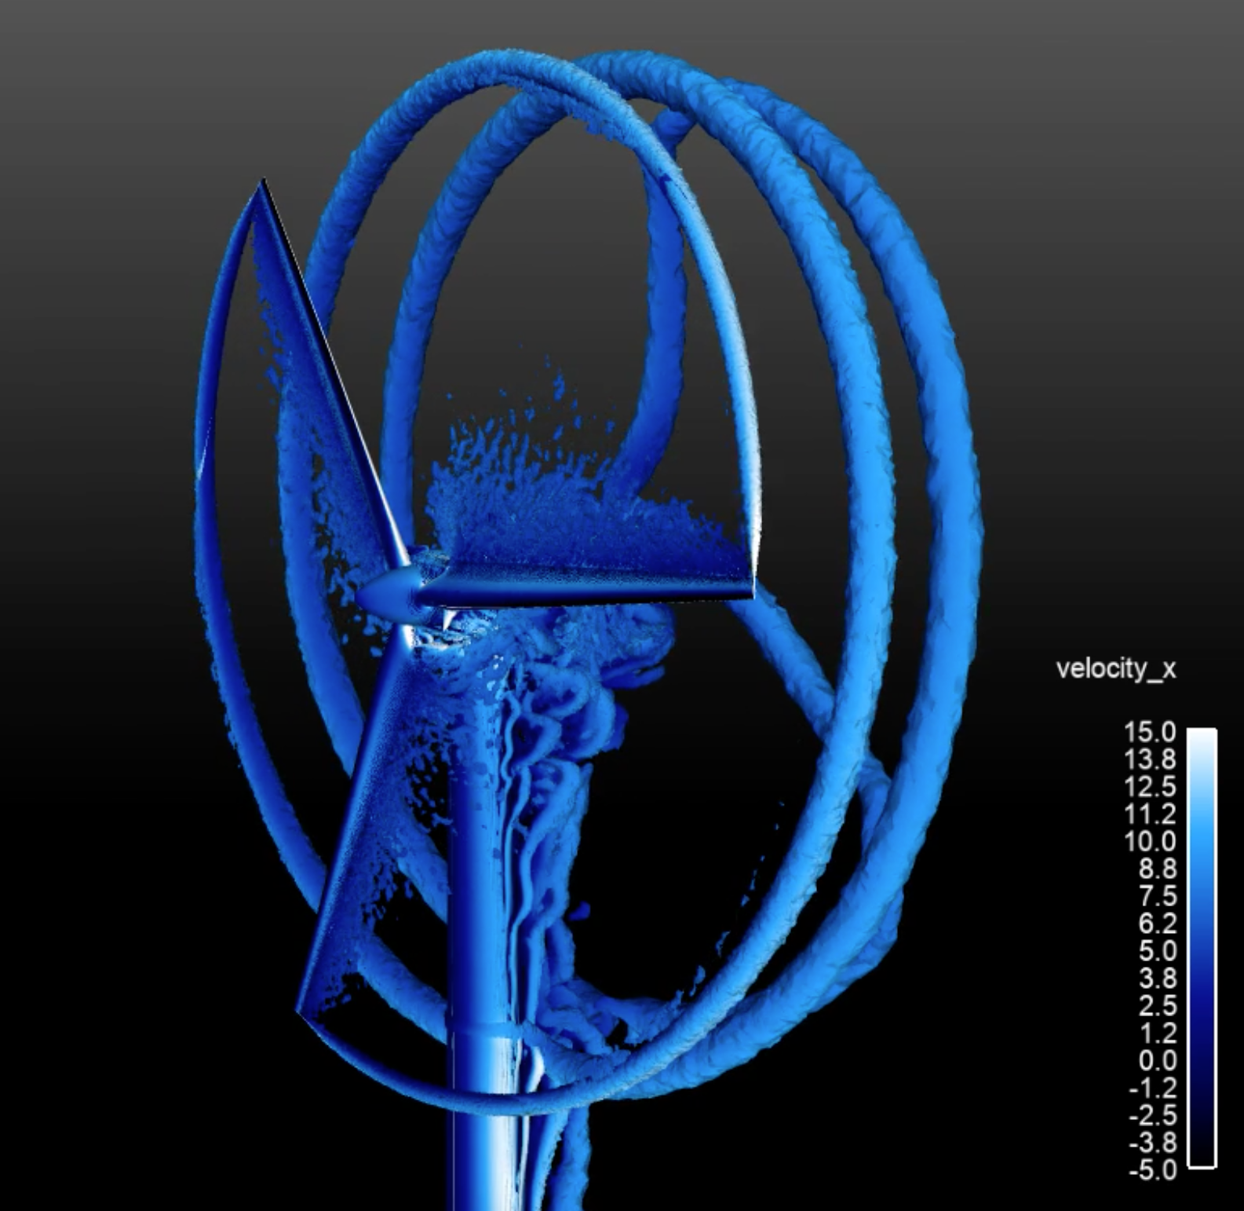
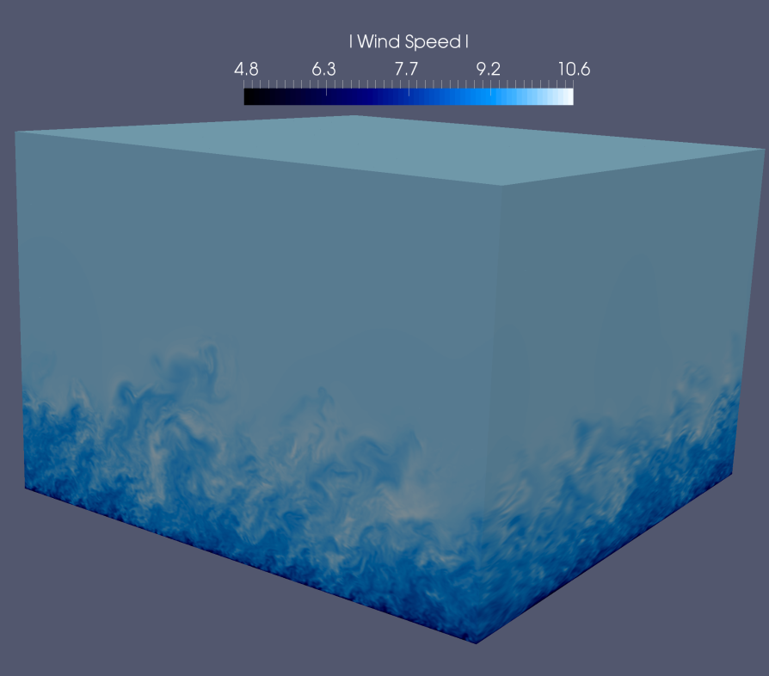
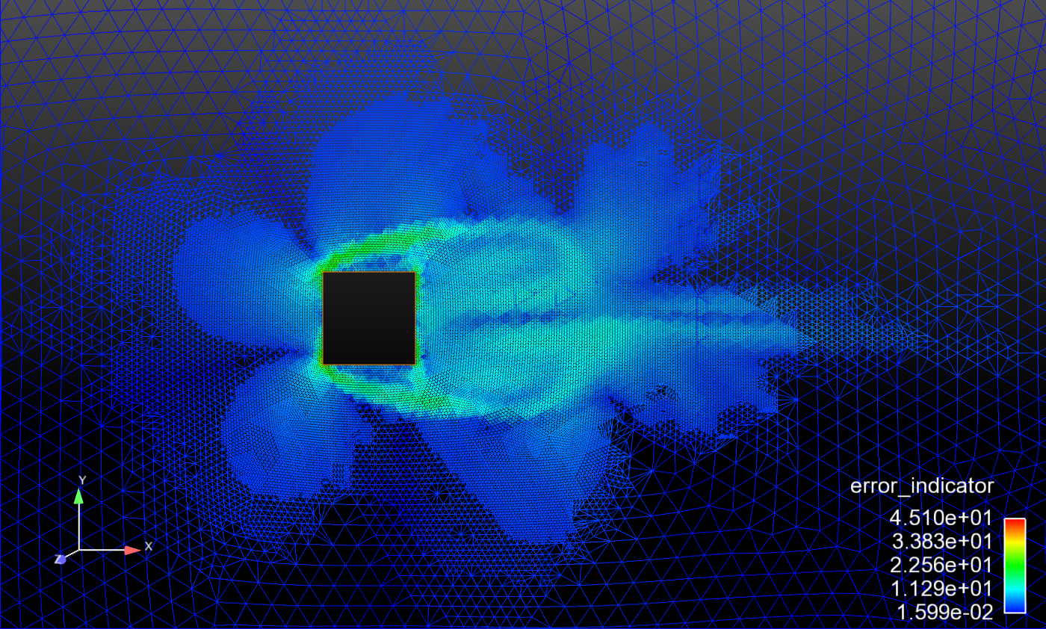
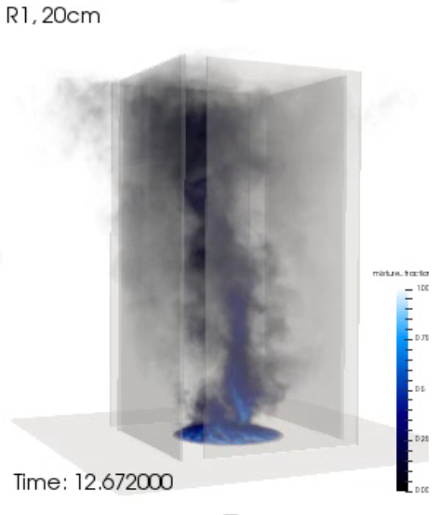
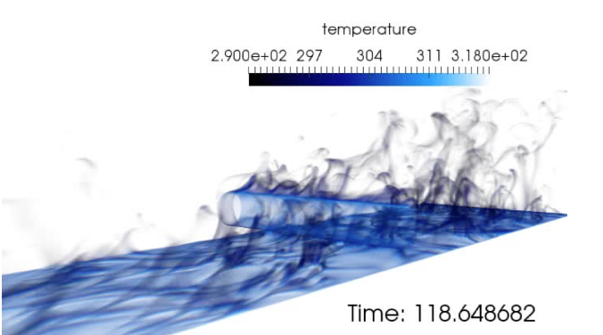
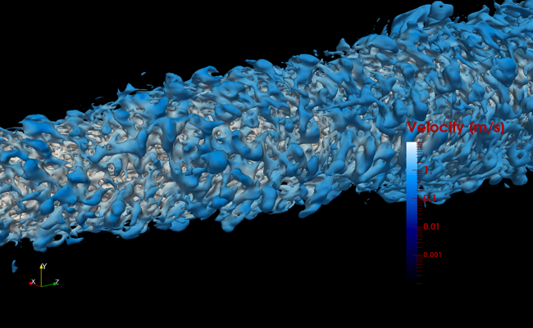
Supported Physics

Slide 6
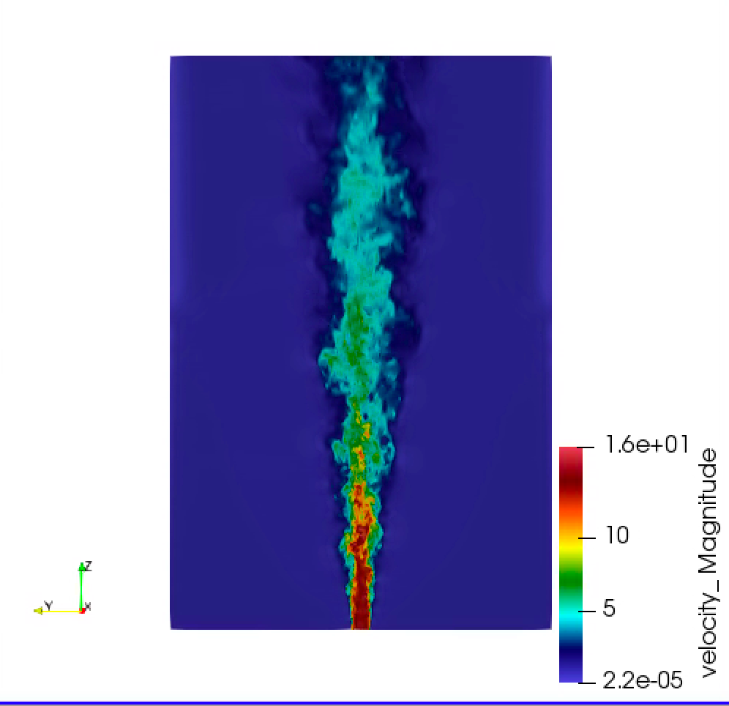


Developed Open-Source BSD-clause 3 Distribution Policy
Philosophy: Open-source collaborations
https://github.com/NaluCFD
(soon)

Slide 7
Nalu History
A time-history of the Nalu code base:
By CFD standards, this is a relatively new code base
Sierra/Nalu
SNL License
Open-source
BSD License (2014)
Github
Nalu
Active
academic partners
ECP ExaWind (2018)
Github
Nalu-Wind
Open-source: SNL, NREL, ORNL, UT joint copyright

Slide 8
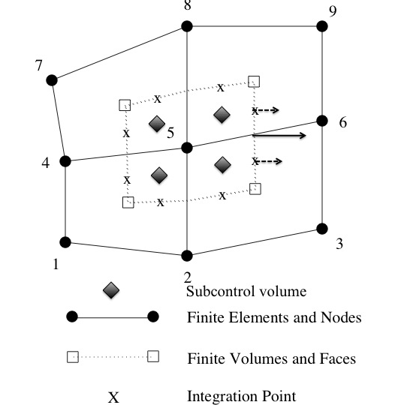
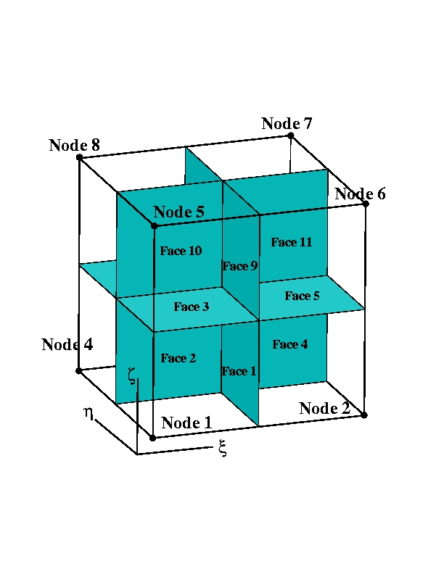
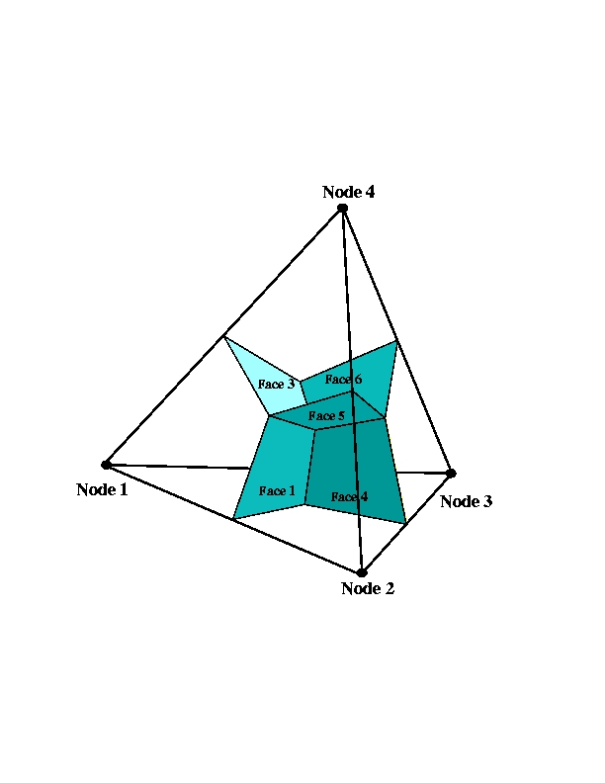
Supported Discretizations: CVFEM/FEM/EBVC
The core discretization used in the low Mach code base has been the Control Volume Finite Element Method, CVFEM
Finite Element Method and Edge-based Vertex-Centered, EBVC, are also supported

Slide 9
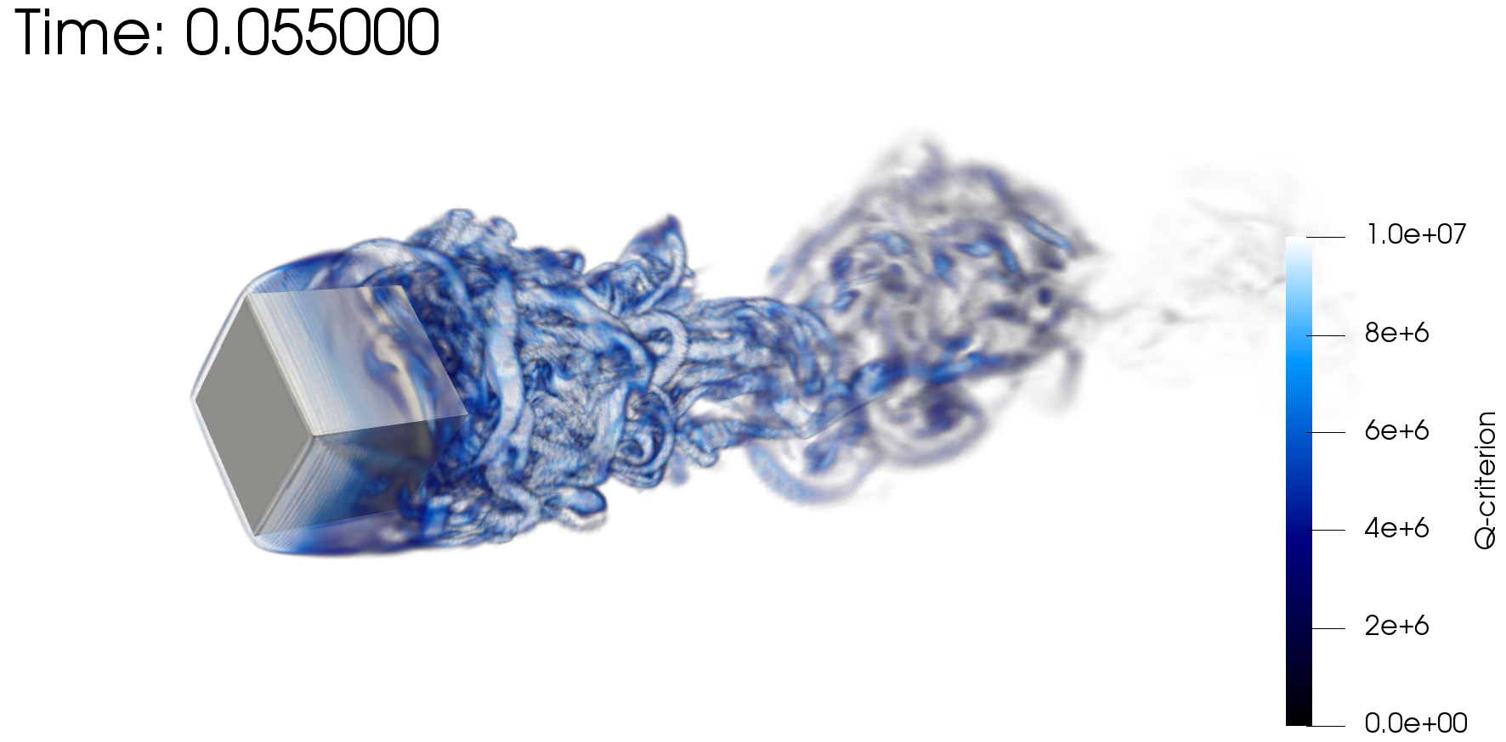

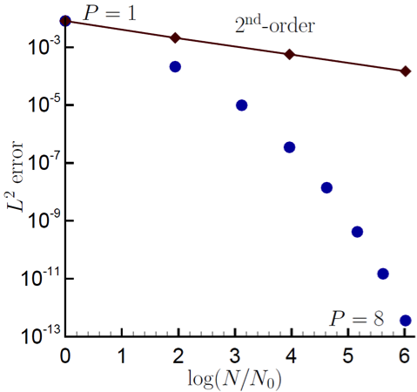
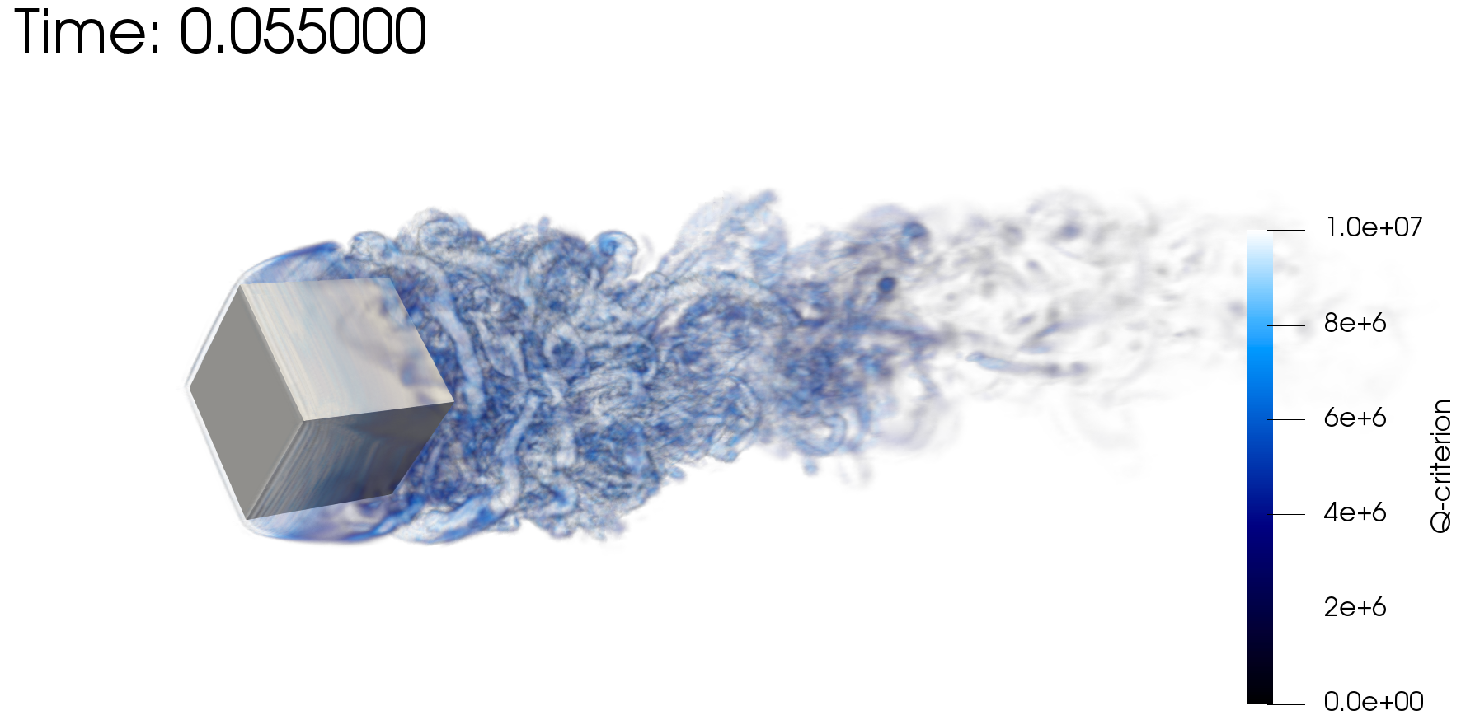
Scientific Research Platform to Evaluate Higher-Order Methods on Next Generation Platforms
As the cost of parallel assembly increases, should we strive to perform more local work? Higher-order achieves this design-point (at the cost of a larger memory footprint)
Spectral convergence
Dual-volume
for promoted quad4
Flow-past rotating cube
Re~4000, RPM~3200
Same node count,
P=1 (top) P=2 (bot)

Slide 10

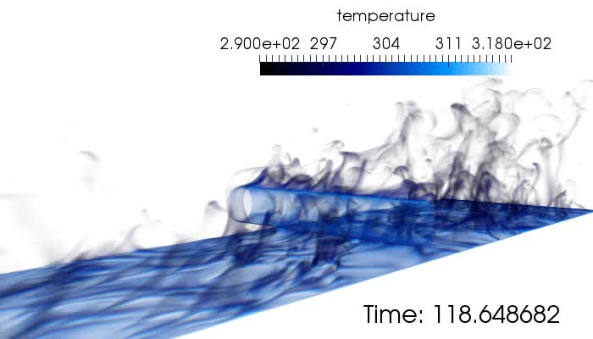
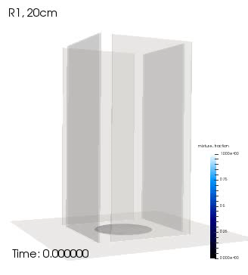
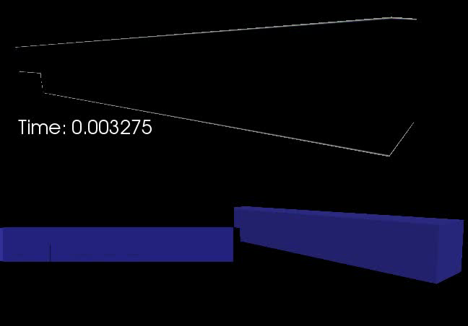
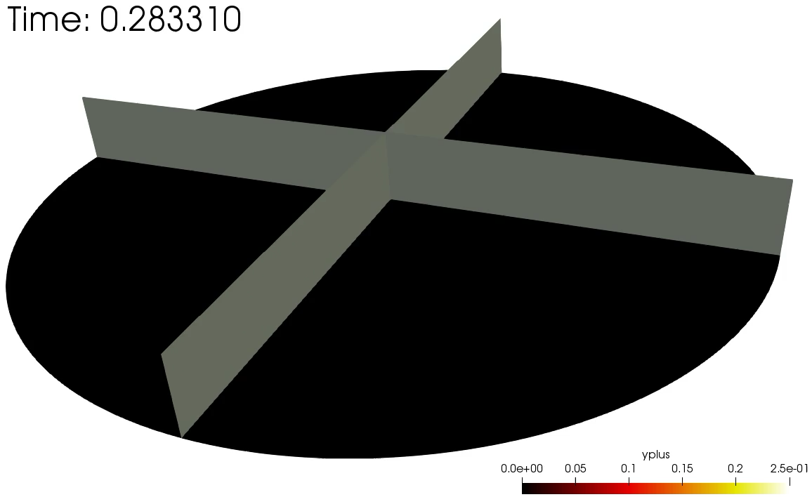
Several Multi-physics Flow Examples
Cylinder in cross flow
Helium plume (low-/high-order)
Heated backstep
Whirling behavior
Impinging Jet DNS

Slide 11
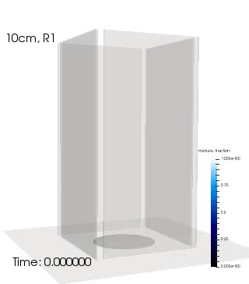
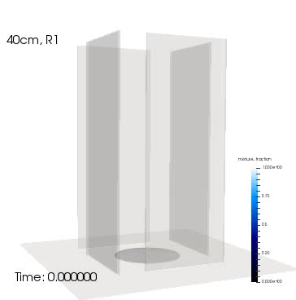
Evolution of a Mindset….. Modeling Whirling-like Flow
SAND2019-7052 C
Idealized chamber in which swirl is provided by selective wall placement in the experimental design
Gap varied between 10, 20, and 40 cm
Objective: Can the onset of swirl be predicted? What is the strength?
Volume rendered mixture fraction
Notes:
Fire whirls are complex phenomena that we are just understanding and, only recently, can model.
This is an example where we have engineered slots in walls that inspire vortical flow in the inner chamber. The plume accelerates upward and, therefore, entrains fluid. The slots provide a large-scale clockwise rotation.

Slide 12
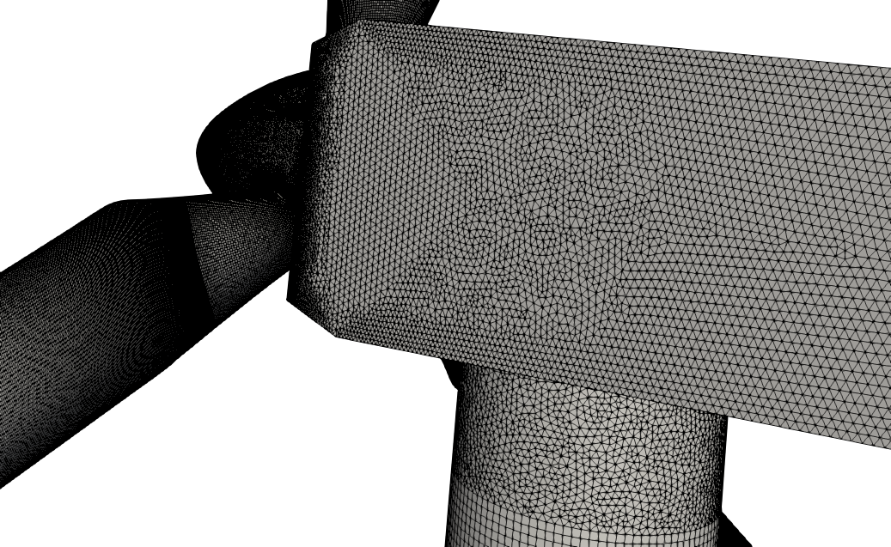
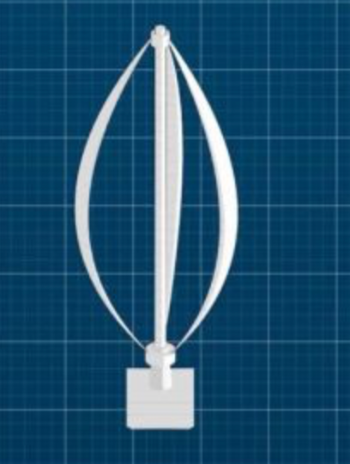
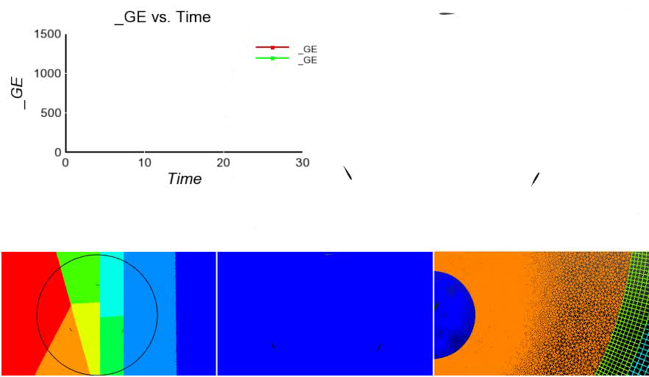
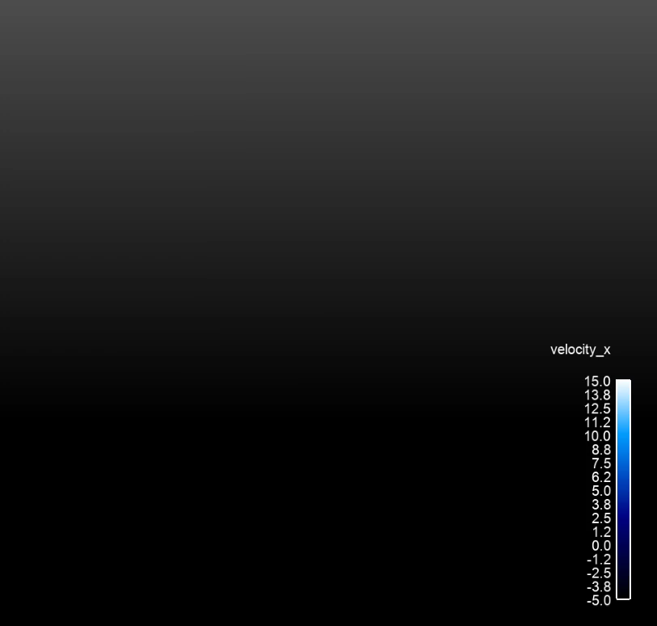
Unique Wind Energy Needs
Low-dissipation methods with suitable nonlinear stabilization operators to perform blade-resolved physics
Complex rotating blades, pitching blades, with possible yaw
Transition from low-order (near the blade) to higher-order (in the wake)
Generalized, unstructured, hybrid low-order simulations shown
Vertical Axis Wind Turbine
(VAWT)
Horizontal Axis Wind Turbine
(HAWT)

Slide 13
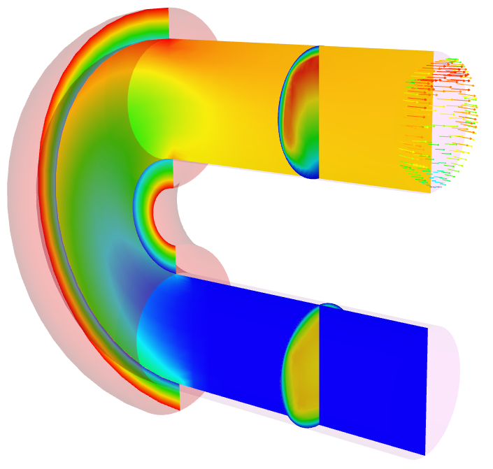
Nalu Abstractions: Polymorphic and Input File-Driven
Time Integration
Nonlinear Coupling
Domain
Realm A
Realm B
1 to many
Interior
algorithms
1 to many
Interior
algorithms
1 to many
boundary
algorithms
1 to many
boundary
algorithms
Transfer
Realm specifications define the physics and desired boundary conditions
Pre-defined EquationSystems (segregated or monolithic)
Operator-split multi-physics
Conjugate heat transfer coupling
Fluids Realm
Heat Conduction Realm

Slide 14
30K View: Anatomy of a Nalu Input File:YAML-based
Simulation:
linear_solvers:
transfers:
realms:
- name: realm_heatCond
boundary_conditions:
- wall_boundary_condition: bc_exposed
solution_options:
initial_conditions:
material_properties:
equation_systems:
systems:
- HeatConduction:
output:
restart:
- name: realm_fluids
TimeIntegrators:
Specification of sparse Trilinos-based precond/solver
Data transfer for multi-physics coupling
YAML enforces strict spacing and ordering
https://www.democraticunderground.com/10021540110
Physics definitions
Time integration, e.g., BE, BDF2

Slide 15
High-Level Elements of an Input File
systems:
- LowMachEOM:
name: myLowMach
- MixtureFraction:
name: myZ
initial_conditions:
- constant: ic_1
target_name: [block_1, …]
value:
pressure: 0
velocity: [0.5,0.0]
mixture_fraction: 0.0
boundary_conditions:
- inflow_boundary_condition: bc_left_inflow
- wall_boundary_condition: bc_front_wall
- open_boundary_condition: bc_right_open
- symmetry_boundary_condition: bc_top
- nonconformal_boundary_condition: bc_nc
material_properties:
target_name: block_1
specifications:
- name: density
type: constant
value: 1.0
- name: viscosity
type: constant
value: 1.8e-5
material_properties:
target_name: block_1
specifications:
- name: density
type: ideal_gas
- name: viscosity
type: polynomial
coefficient_declaration:
- inflow_boundary_condition: bc_left
target_name: surface_1
inflow_user_data:
velocity: [0.5,0.0,0.0]
mixture_fraction: 0.0
- wall_boundary_condition: bc_back
target_name: surface_7
wall_user_data:
user_function_name:
velocity: wind_energy
user_function_string_parameters:
velocity: [mmTop_ss7]
mixture_fraction: 1.0

Slide 16
Test Case Input Files
All input files are part of the Nalu regression test suite: Nalu/reg_test/test_files
Mesh files are found under: Nalu/reg_test/mesh
Formally, /mesh is a git submodule
Test Cases Highlighted:
Nalu/reg_tests/test_files/dgNonConformalThreeBlade
Nalu/reg_tests/test_files/fluidsPmrChtPeriodic
Homework #1:
https://github.com/spdomin/Present/tree/master/standformMe469/hwOne
Feel free to run any case that you feel looks interesting to you!
Note that the regression test suite is (mostly) focused on providing code coverage and may not represent “sane” physics-based choices
Resource: https://nalu.readthedocs.io/en/latest/source/theory/index.html

Slide 17
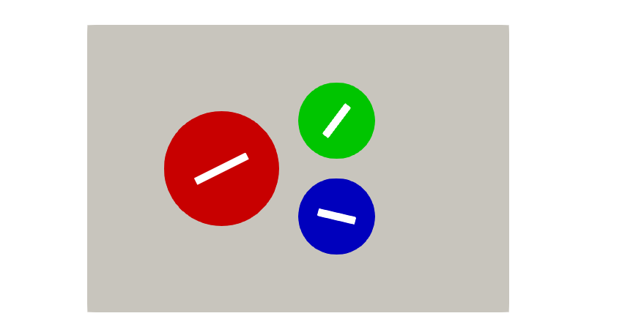
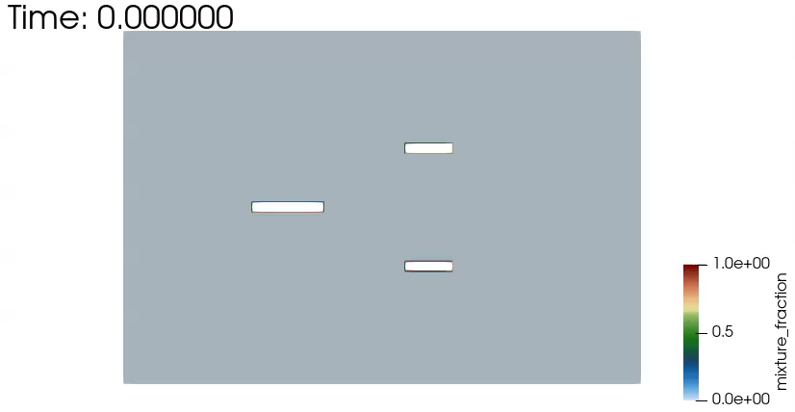
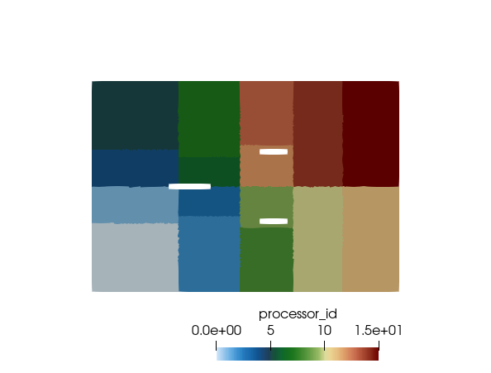
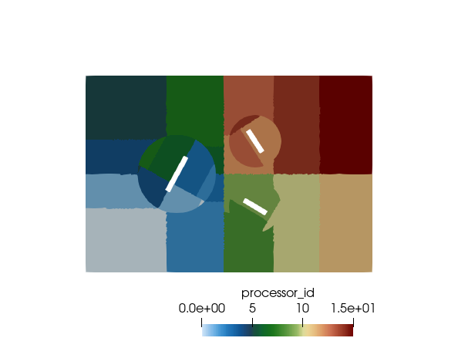
Nalu/reg_tests/test_files/dgNonConformalThreeBlade
Physics
Flow past rotating square blades (Re = 10,000)
Models
Newtonian fluid (air) with constant properties
Boundary Conditions
Inflow, open, symmetry, DG/CVFEM interface
Domino, JCP, 2018
>mpirun --np 4 /naluPath/naluX -i dgNonConformalThreeBlade.i &

Slide 18
Nalu/reg_tests/test_files/dgNonConformalThreeBlade
UΔt/Δx
γ_{i} for BDF2
Time Step Count: 7 Current Time: 0.0127268
dtN: 0.00266002 dtNm1: 0.00231306 gammas: 1.53488 -2.15 0.615116
Max Courant: 1.54421 Max Reynolds: 236.792 (realm_1)
Realm Nonlinear Iteration: 1/1
realm_1::advance_time_step()
NLI Name Linear Iter Linear Res NLinear Res Scaled NLR
--- ---- ----------- ---------- ----------- ----------
1/2 Equation System Iteration
1/1 myLowMach
MomentumEQS 4 1.27653e-07 0.000173716 1
ContinuityEQS 9 5.17721e-06 0.00618278 1
PNGradPEQS 19 4.2818e-09 2.78318e-06 1
PNGradUEQS 20 9.70201e-09 5.20951e-06 1
1/1 myZ
MixtureFractionEQS 5 1.31346e-09 6.84724e-06 1
PNGradZEQS 5 6.33586e-09 3.66957e-06 1
2/2 Equation System Iteration
1/1 myLowMach
MomentumEQS 5 8.33682e-10 2.23818e-06 0.0128842
Mass Balance Review:
Density accumulation: 0
Integrated inflow: -0.375
Integrated open: 0.3749998354138842
Total mass closure: -1.64586e-07
Mean System Norm: 0.0002458198407611864 7 0.0127268
ρ U L / μ
equations
nonlinear
iterations
Review

Slide 19
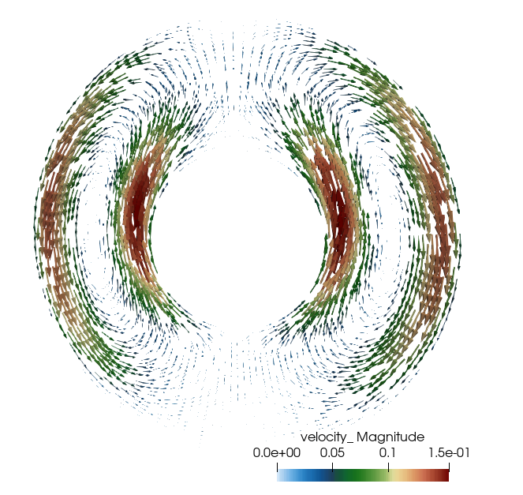
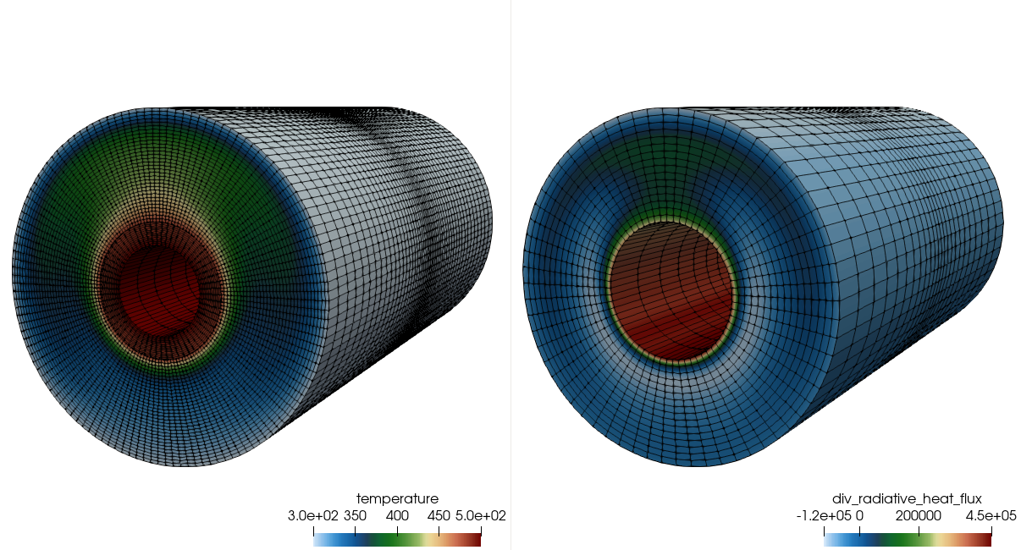
Nalu/reg_tests/test_files/fluidsPmrChtPeriodic
Physics
Uniformly emitting/absorbing participating media radiation (PMR) conjugate heat transfer (CHT) with buoyancy
Models
Newtonian fluid (air): ideal gas
Boundary Conditions
Wall, periodic
Stark#, cond/rad
Sk = λ μ / σ T_{i}³ ~ 0.4
Rayleigh#, τ^{ThermalDiff}/ τ^{Conv}
Ra = g β (T_{i} – T_{o} ) L / Pr α² ~ 2e6
>mpirun --np 8 /naluPath/naluX -i fluidsPmrChtPeriodic.i &

Slide 20
Nalu/reg_tests/test_files/fluidsPmrChtPeriodic
Temperature
Irradiation
Conduction
Heat Transfer,
Enclosure Radiation
SURFACE
Participating
Media
Radiation DOM
STK
Transfer
Temperature, μ_{g}
RTE Src
Linearized
Temperature
Convection Coef.
Reference Temp
SURFACE
۰q_{r}
VOLUME
Δ
Turbulent
Fluid Mechanics,
Combustion
Monolithic, i.e., fully coupled, approaches are intractable due to the size of (u, v, w, p, h, h^{r}, Z, I^{k} T)^{T}
Stable and accurate operator split methods are, therefore, sought
See Domino et al., AIAA, 2007

Slide 21
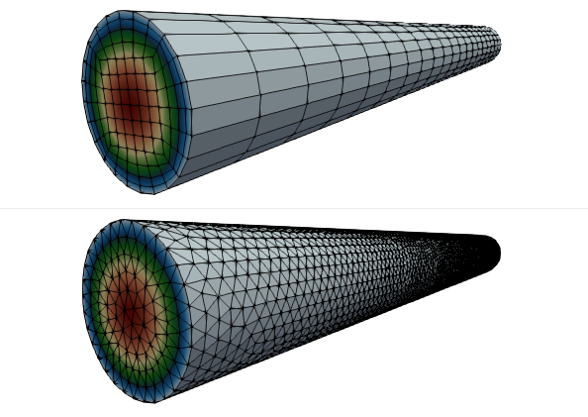
Laminar Pipe Flow: Specified Pressure Drop for Re^{τ}= 10
Physics
Laminar pipe flow (specified pressure drop)
Models
Newtonian fluid (air): ideal gas
Boundary Conditions
Wall, open (pressure specified)
Location: https://github.com/spdomin/Present/tree/master/stanfordMe469/hw/one
Specifications:
Re^{τ} = 10
Pipe diameter, D = 0.01 m
Pipe Length, L = 0.2 m
ρ = TBD
μ = TBD
dp/dz = TBD
Uc = TBD

Slide 22
Nalu Overview: Conclusion
Nalu’s technology has its roots in the ASC Sierra/Fuego effort
Multi-physics capabilities are in development
Research platform for high-order low-Mach methods
Open-source collaboration model
Funded through ASC, ECP, A2e, ASCR, and LDRD

